Slide 1
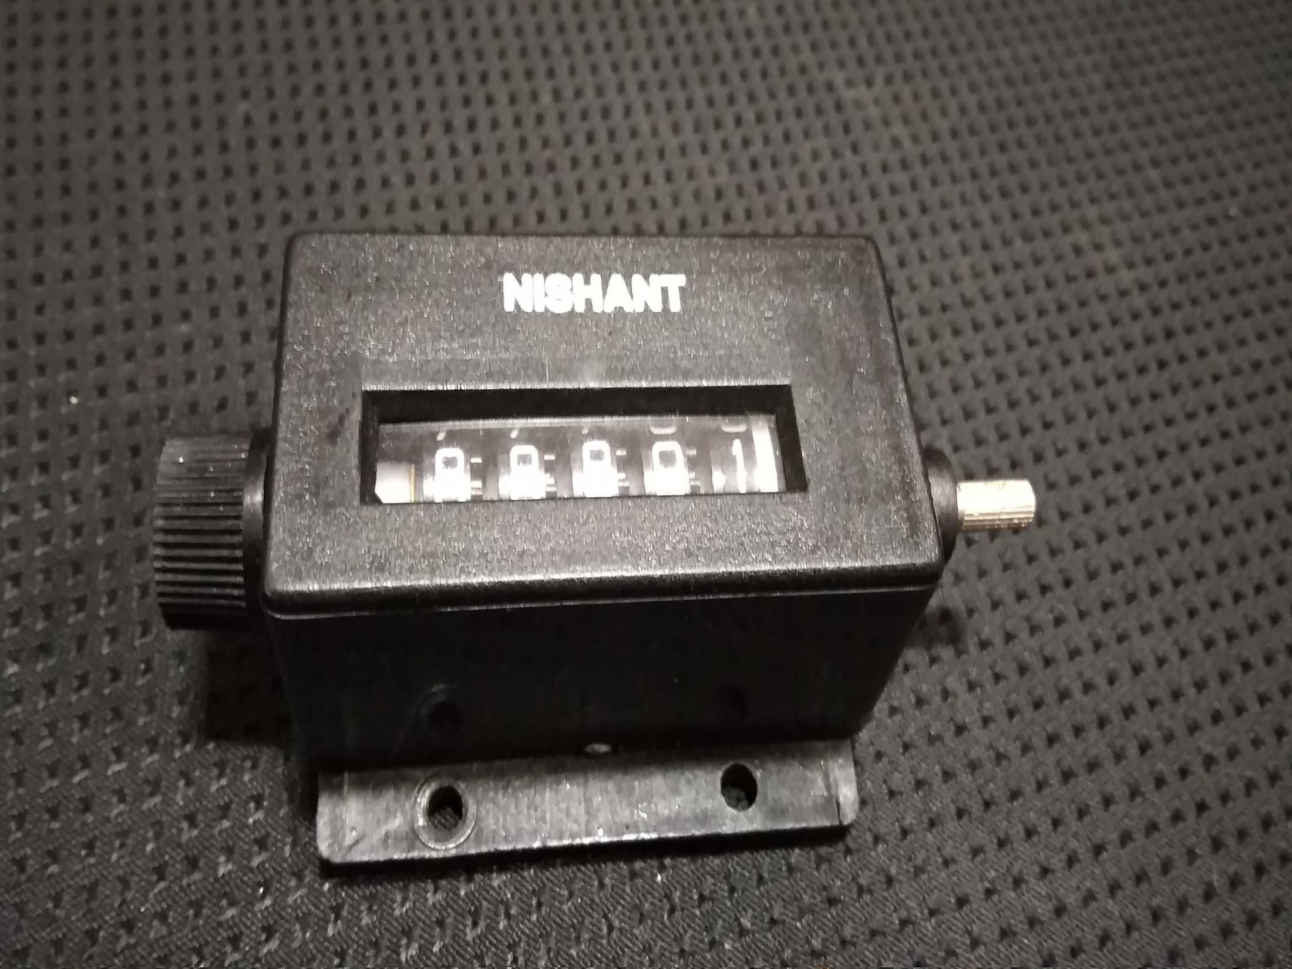
RS5 STROKE COUNTER
OPERATION/WORKING

Slide 2
INTRODUCTION
Stroke counter is a mechanical device which is designed to count the number of strokes/operation of the product on installation.
Specification of Stroke Counter is RS5 which means that the stroke is given on the right hand side & it is a 5 digit counter i.e., maximum of 99999 strokes can be counted.

Slide 3
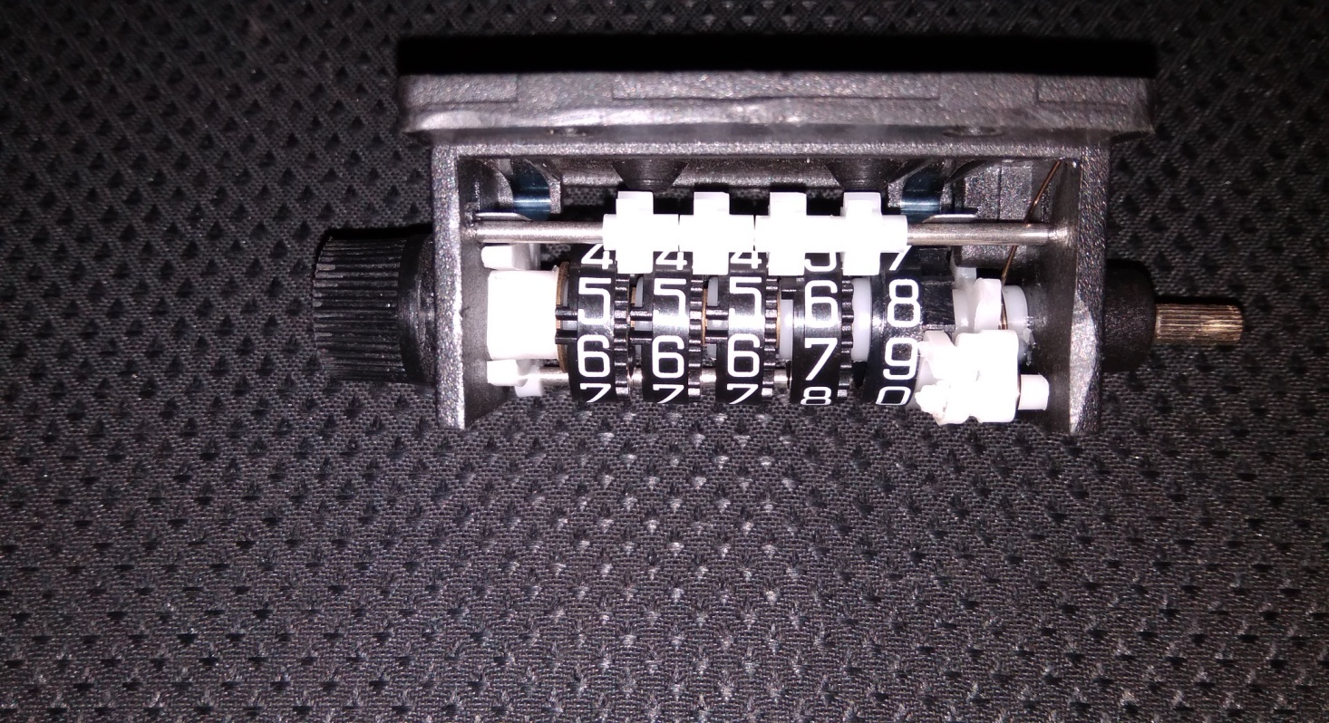
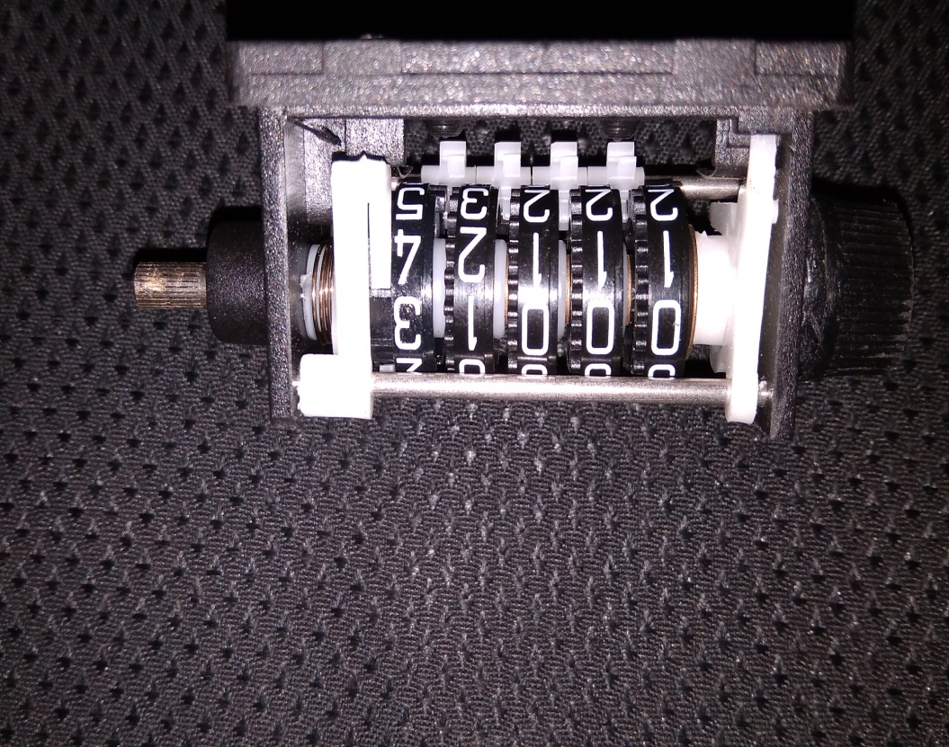

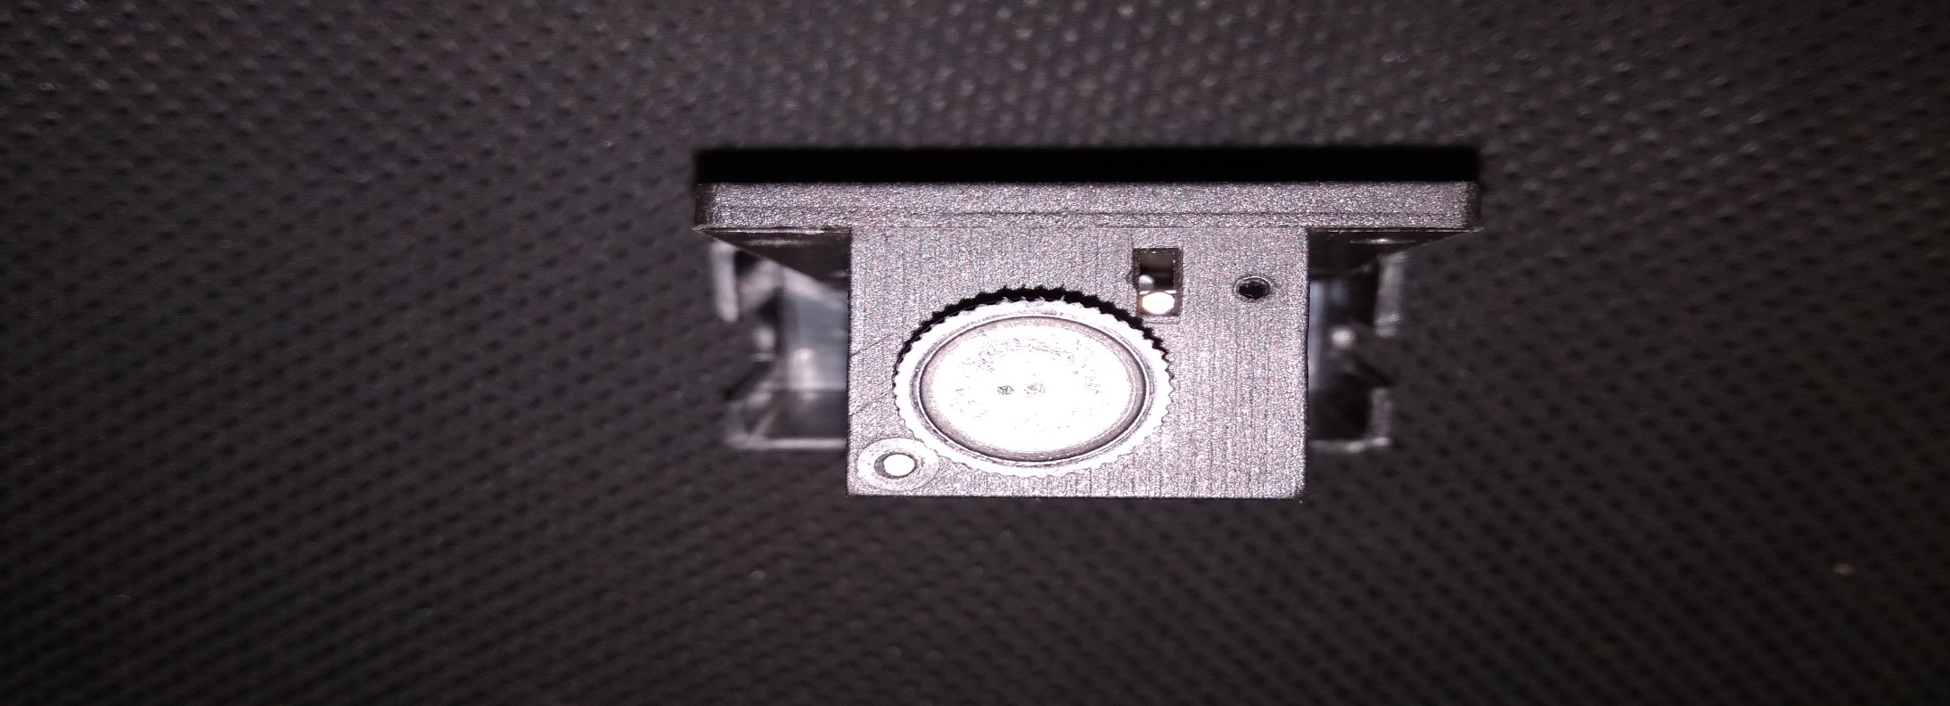
DESIGN/VIEWS
BACK VIEW
FRONT VIEW
RIGHT SIDE VIEW
LEFT SIDE VIEW

Slide 4
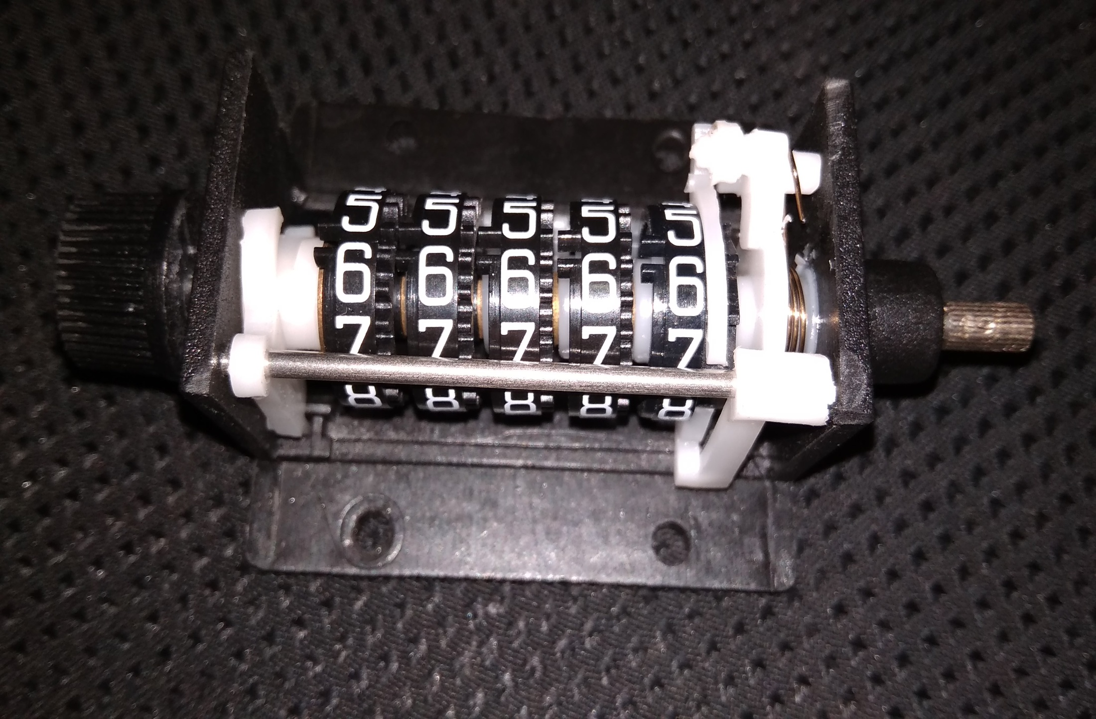
CONSTRUCTION
MOUNTING PLATE
DIGIT ROLL
MAIN ROTATING SHAFT
SPRING FOR RATCHET MECH
RESET WHEEL
FIXED SUPPORT SHAFT
BASE

Slide 5
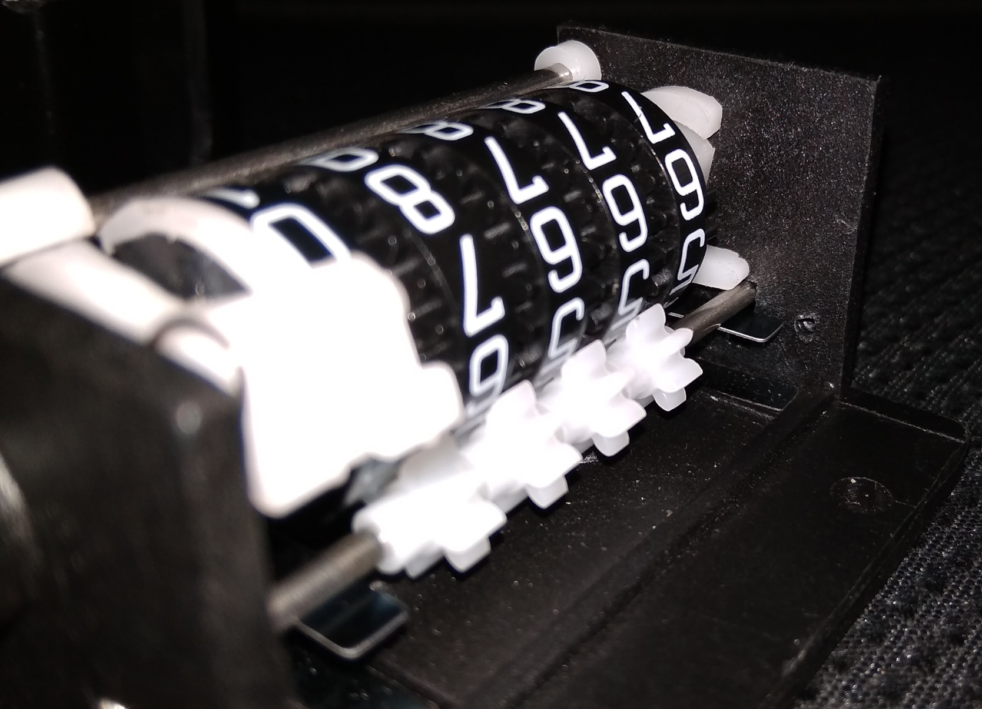
GEAR LIKE ASSEMBLY
SPRING

Slide 6

OPERATION / WORKING
THE NORMAL SINGLE DIGIT OPERATION OF THE COUNTER IS GIVEN BELOW IN THE VIDEO:

Slide 7
THE NORMAL DOUBLE & TRIPLE DIGITS OPERATION IS GIVEN BELOW IN THE VIDEO:

Slide 8
During the product operation, the clockwise rotation force is given to the main shaft.
This force is carried out to the ratchet mechanism. The digit roll attached to the ratchet also rotates and increase the count by 1. The reverse rotation is locked by a locking clip so that the rotating clip glides over the ratchet teeth and locks with the next teeth for further count.
The two videos below will be helpful to understand this mechanism.

Slide 9
ROTATING CLIP
REVERSE LOCK CLIP

Slide 10
To reset the count, a resetting wheel is given in the left.
When the wheel is rotated, a curved lever under the digit rolls also rotates with a common fixed point on the roll to equalise all the digits. So it can be easily reset to 0’s.
The working of this mechanism is given below in the video.

Slide 11
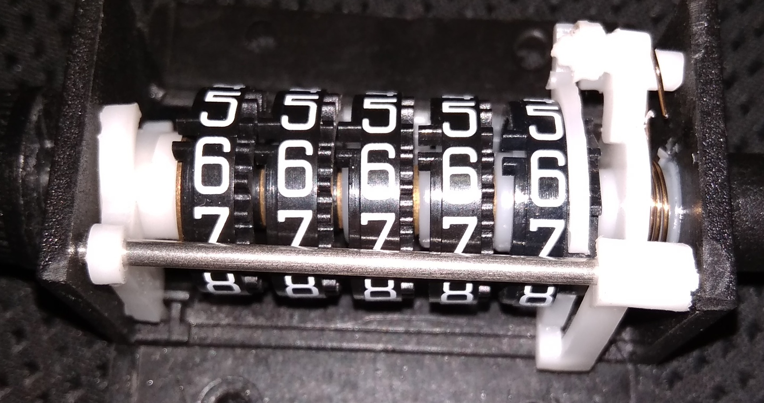
The single digit movement after 9 should turn the tens digit by 1 or the next number. For this movement two tooth is given between the number 5 & 6 on the left side of all the rolls.
This tooth locks with the gear so that this movement is carried to the next digit roll and increase the count by 10.

Slide 12
A slow motion video is given below to better understand the working of this mechanism:

Slide 13
THANKYOU
FOR YOUR ATTENTION

